Slide 1
Global Technological Innovation
New York City / Washington DC

Slide 2
Plan for today
Getting to know one another
Review of the course’ requirements
Logistics information

Slide 3
Getting to know one another
Your background
Your motivations
Your expectations

Slide 4
Global Technological Innovation
The “Campus United States” course will take place in the cities of Washington DC from May 29 to June 2, 2022, and New York from June 2 to 8, 2022. A group of 16 graduate and undergraduate management students will be part of it.
In this course, students learn about a foreign business culture through meetings with senior executives and foreign government officials, academic conferences, as well as hands-on activities aimed at integrating knowledge.

Slide 5
Global Technological Innovation
The theme of this campus relates in particular to Global Technological Innovation. Coming to New York and Washington, we will explore the role of US East Coast businesses in the global artificial intelligence revolution, the role of venture capital, the impact on regulations, and consideration of the ethical dimension.
Usually, visits consist in spending roughly 90 min-120 min with the hosts from the institution visited. We often have a tour (contingent on the health situation) then a quick corporate presentation of the organization or the department visited. Then, it is followed by Q&As.

Slide 6
Examples of visits
Tech firms
Government
Geopolitical impacts

Slide 7
Assessment
Participation: 20%
Teamwork
Roll-your-own research: 30%
Individual work
Ambassador of the day: 10%
Post-campus reflection paper: 40%

Slide 8
Assessment
Team creation and examples of topics:
Here: https://nuage.nuance-r.com/index.php/s/MT6j5GREeHb4jKR
Ambassador of the day:
Here: https://nuage.nuance-r.com/index.php/s/QreQtiR5J7y6ZLN

Slide 9
Timeline
Predeparture Meeting 1: March 31
Course requirements and logistics
Predeparture Meetings 2 & 3: May 26 & 27 9 AM – 12 PM
Seminars on the course’ themes
Campus: May 29 to June 8

Slide 10
Agenda
Monday | Tuesday | Wednesday | Thursday | Friday | Saturday | Sunday
 |  |  | May 26 HEC Montreal 9.00 am -12.00 pm Meeting | May 27 HEC Montreal 9.00 am -12.00 pm Meeting |  | May 29 Washington DC Check-in Welcome Dinner 6.30 PM
May 30 Washington DC | May 31 Washington DC | June 1 Washington DC | June 2 Washington DC Train from DC to NYC | June 3 NYC | June 4 NYC | June 5 NYC
June 6 NYC | June 7 NYC Farewell dinner | June 8 NYC Check-out End of Campus

Slide 11
Logistics
HEC Montréal takes care of:
All academic and business activities
Accommodation (10 nights incl. WIFI)
Train ticket DC - NYC
Some cultural activities
Two dinners

Slide 12
Logistics
You take care of:
Transportation MTL – Washington DC ; New York City – MTL
Local transport in DC and NYC
Visa or ESTA
Insurances
Making sure you are following all COVID-19 requirements to the US
Your meals
Your allergies and alimentary requirements
Your free time activities

Slide 13
International Transportation
Important dates
Arrival in Washington DC: May 29 for the welcome dinner at 6.30 PM (first night included)
Last night included in NYC : June 7. Farewell dinner to close the trip.
Hotel check-out : June 8. No activities on this date.
You can arrive earlier and leave later (extra days at your own expense)
We will ask you to send us a copy of your travel itinerary

Slide 14
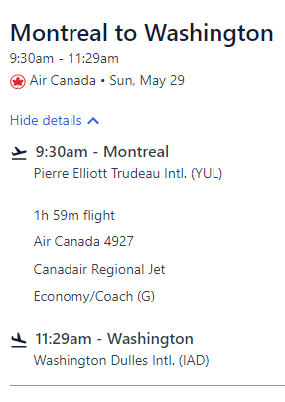
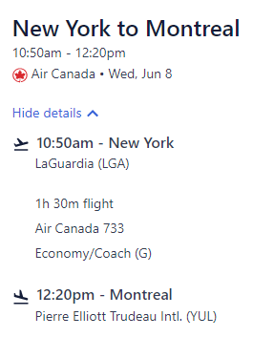
Example of a plane itinerary (MTL – Washington DC - NYC - MTL)
What to consider:
Duration of itinerary
Number and length of layovers
Connexions (visa needed? PCR Test?)
Price is not the only indication of a good itinerary

Slide 15
Luggage
Business dress code during company visits
We recommend bringing one piece of luggage of a weight that you can carry without assistance
Everyone must carry a gift

Slide 16
Travel Insurance
It is mandatory to be covered with travel medical insurances including COVID coverage, for the full length of the trip.
You need to provide us with a proof of medical insurances coverage
We strongly recommend subscribing to cancellation/interruption insurances as well. The insured amount should cover the full amount of the Campus Abroad USA (international transport + travel fees).
Under no circumstances will HEC Montréal reimburse transport tickets

Slide 17
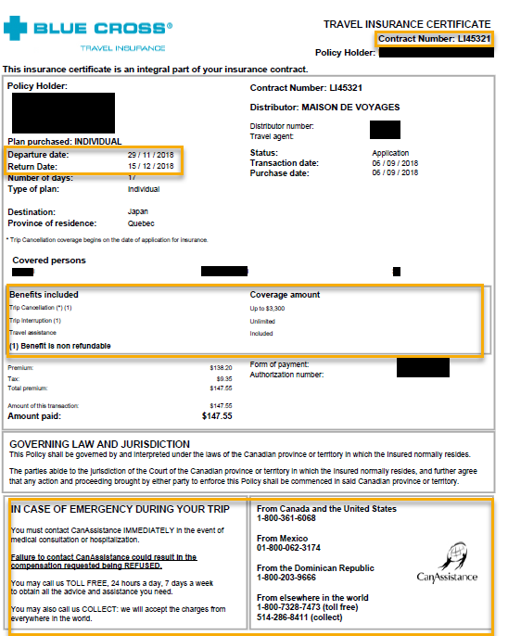
Valid proof of insurance
Includes:
Your name
Policy number
Date of validity
Detail of coverage
Emergency number

Slide 18
Entry requirements to the US
You must have 6 months validity on your passport from the date of arrival in the US
If you are asked the question at the border or in your visa procedure: this trip is a tourism/leisure trip
Find out whether you need a visa
https://travel.state.gov/content/travel/en/us-visas.html
Canadian citizens do not need a visa
Some European citizens are eligible for ESTA
https://esta.cbp.dhs.gov/
Should you need visa support, please contact me

Slide 19
Entry requirements to the US
Rules for airplane travellers as of March 30, 2022
Mandatory proof of vaccination
Mandatory travel attestation given by airline
Mandatory COVID-19 Test
Proof of negative pre-departure COVID-19 test results (Antigen, Nucleic-Acid, RT-PCR, RT-Lamp or TMA test)
The test must be taken a maximum of 1 day before the first scheduled departure time in the flight itinerary
Notes:
Exemption
Travellers who have recovered from COVID-19. These travellers must show proof of a positive viral test from the preceding 90 days and a letter from their healthcare provider or public health official stating they are cleared for travel.

Slide 20
Entry requirements to the US
Rules for land travellers as of March 30, 2022
Non-U.S. individuals traveling to the United States via land ports of entry or ferry terminals, whether for essential or non-essential reasons, must:
verbally attest to their COVID-19 vaccination status;
provide proof of a CDC-approved COVID-19 vaccination (QR Code);
present valid passport
COVID-19 testing is not required for entry via a land or ferry port of entry.
Notes:
https://www.dhs.gov/news/2021/10/29/fact-sheet-guidance-travelers-enter-us-land-ports-entry-and-ferry-terminals
https://www.canada.ca/en/public-health/services/diseases/coronavirus-disease-covid-19/vaccines/vaccine-proof.html

Slide 21
Entry requirements to Canada
Rules for airplane + land travellers as of March 30, 2022
Mandatory proof of vaccination
ArriveCan is mandatory
Notes:
https://travel.gc.ca/travel-covid/travel-restrictions/covid-vaccinated-travellers-entering-canada

Slide 22
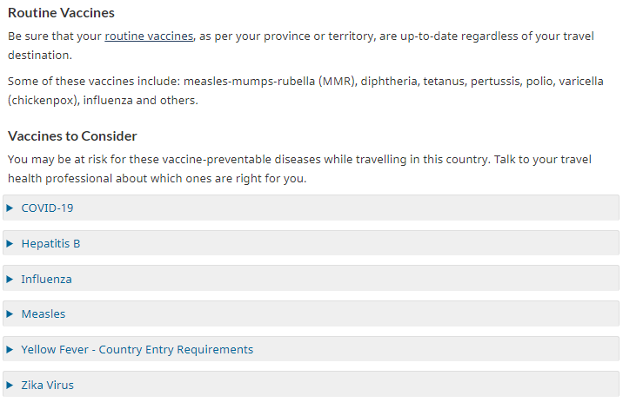
Health
Check whether other vaccines are recommended in your case
You can consult a health care provider or visit a travel health clinic before travelling
Masks may be mandatory in certain places
Tap water is usually drinkable in DC and NYC
https://travel.gc.ca/destinations/united-states

Slide 23
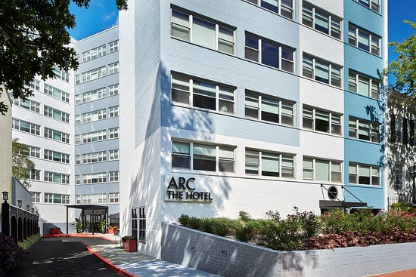
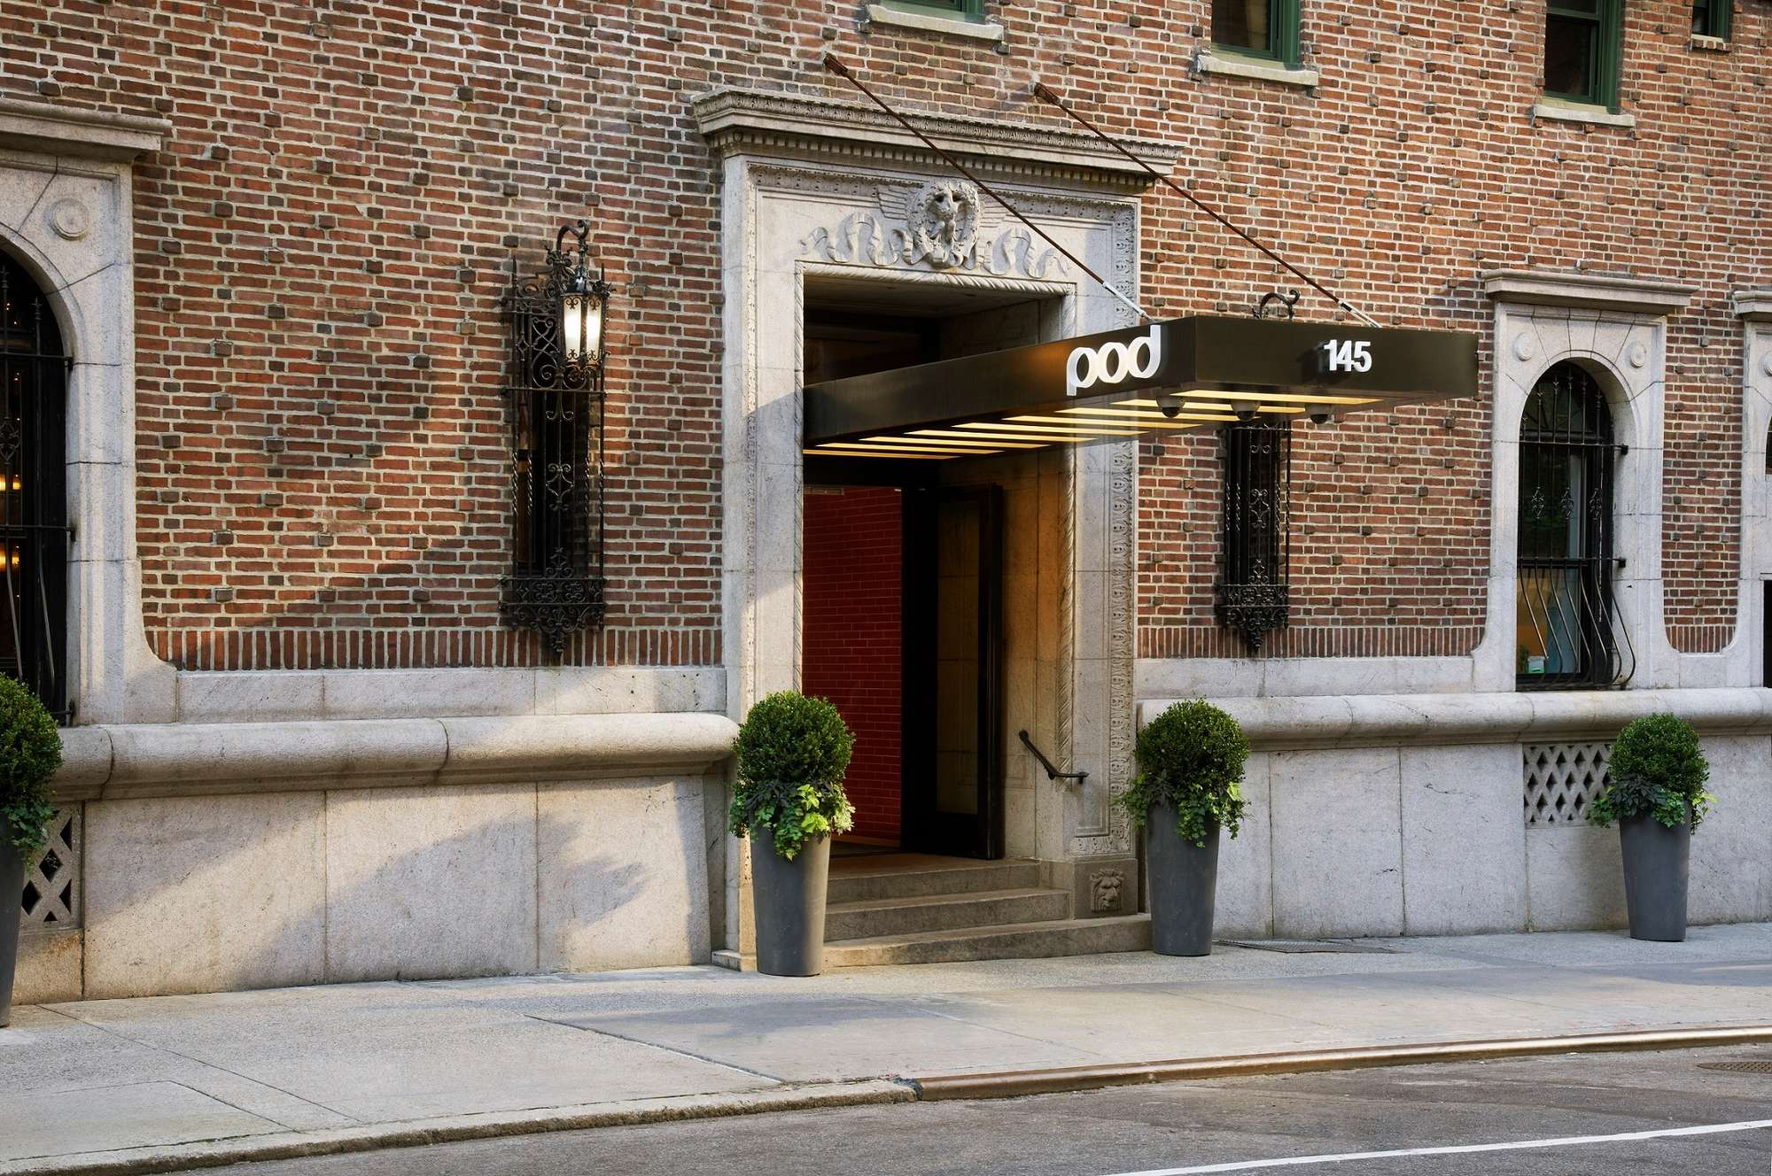
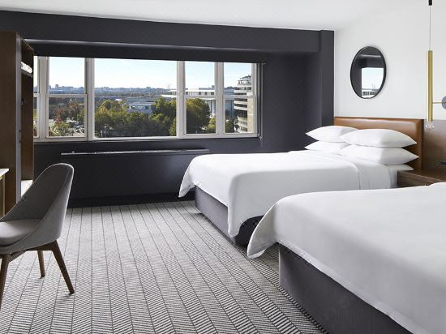
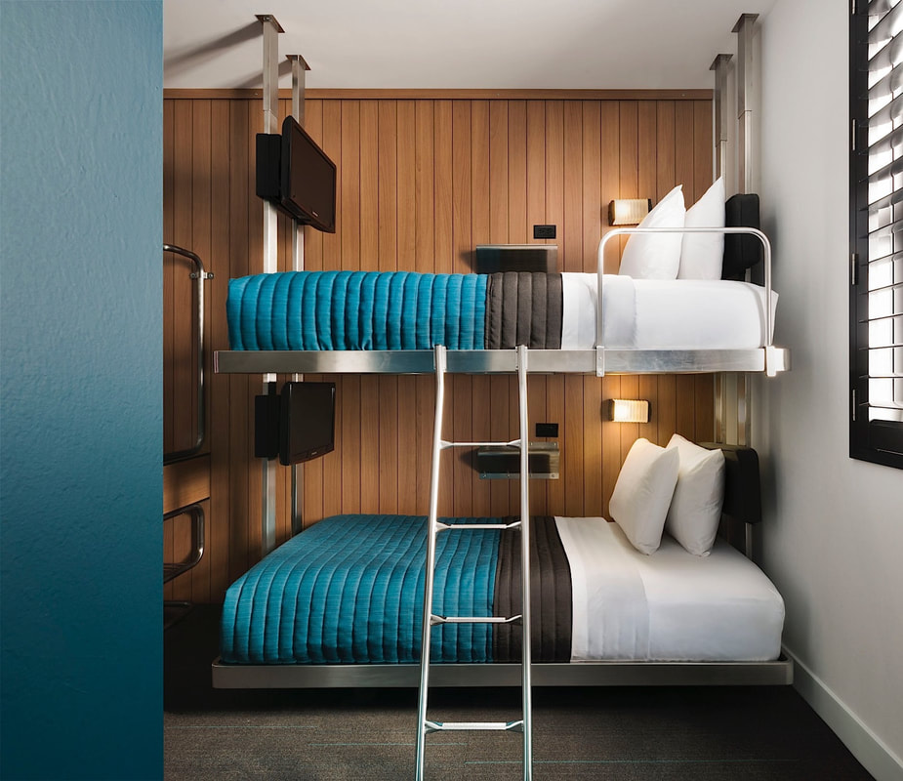
Hotels
Double Occupation (2 beds)
Wifi included
ARC Hotel DC
4 nights
824 New Hampshire Ave NW, Washington, DC 20037
Pod 39 NYC
6 nights
145 E 39th St, New York, NY 10016

Slide 24
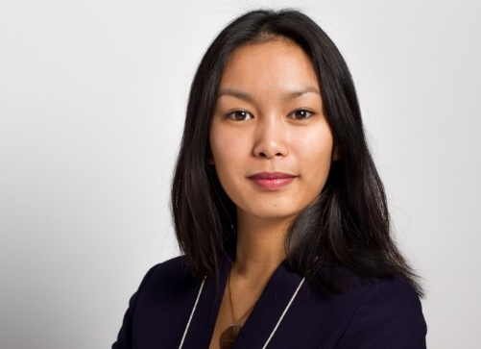
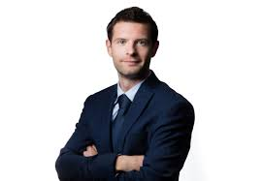
Campus USA Booklet
We will be sending a booklet introducing the program and the group to the companies that we will be visiting.

Slide 25
Budget
To be paid to HEC Montréal
Institutional fees (HEC en ligne) | 234 $
Travel fees (activities, train ticket, hotels, two meals) | 1600 – 1800 $
TOTAL | 1834 – 2034 $
Travel fees will be due on May 1st
Payment will be done by check and in one single installment

Slide 26
Next steps
Please send me before April 8 :
One page CV in English
Professional picture
Due on May 1st :
Completed form (insurances, health)
Travel itinerary
Travel Fees Payment

Slide 27
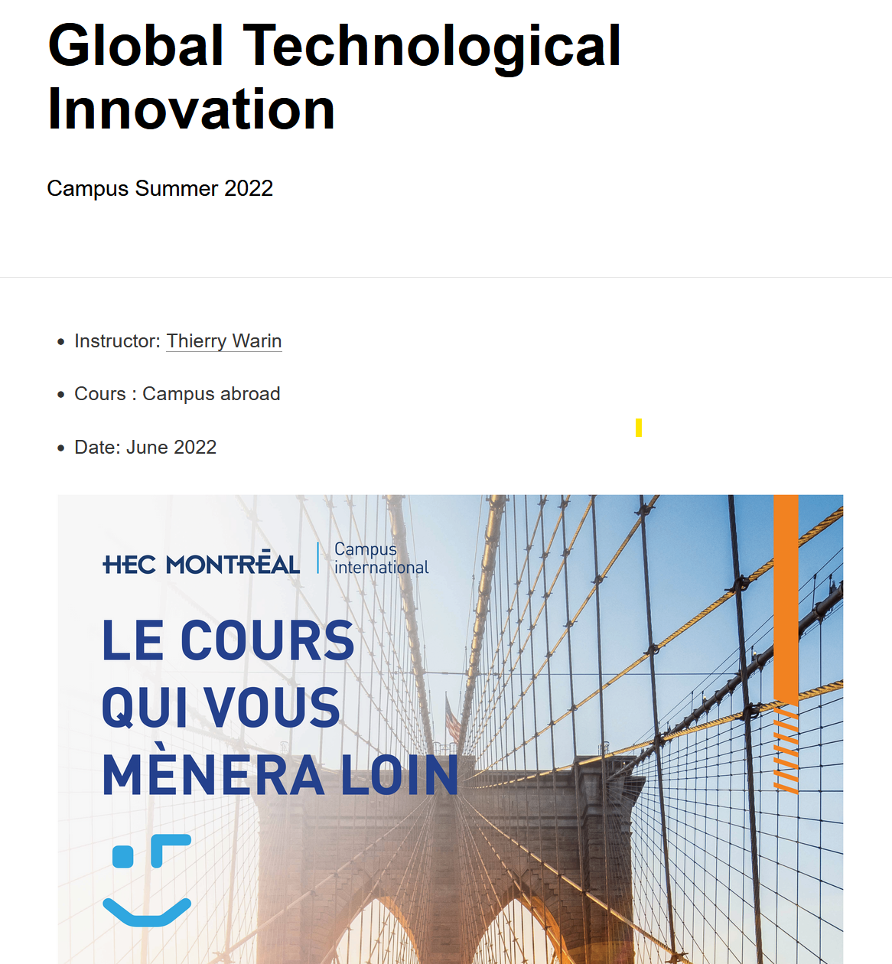
Further information:
https://warin.ca/campusus/
Email: thierry.warin@hec.ca
Phone: 514 340-6185

