Slide 1
AI, Science and Society
Th. Warin, PhD | PMIA / OECD / CEIMIA / OBVIA

Slide 2
Introduction
GenAI, Open source AI, Techno-nationalism, technological sovereignty, data colonialism, algorithmic transparency, AI governance, digital autonomy, big data analytics, algorithmic accountability, responsible AI, platform capitalism, machine learning fairness, data centers, platform economy, AI factory, Trustworthy AI, AI4Good, Society 5.0…

Slide 3
Introduction
Echoing Confucius’s assertion that “when words lose their meaning, human beings lose their freedom,” this approach to conceptual clarity is not merely theoretical but crucial to maintaining an informed and liberating discourse.
… not generated by DeepSeek

Slide 4
Ai, Science and Society
Originating from Japan, Society 5.0 proposes a “super-smart” social system where digital technologies, especially AI, fully integrate with societal aims (Keidanren, Society 5.0: Co-creating the future, 2018).

Slide 5
Ai, Science and Society
My personal journey:
Multiple words = multidisciplinarity
I need an epistemological lens that views AI as more than just a technical tool, recognizing the cultural, political, and economic contexts that shape its development.

Slide 6
Ai, Science and Society
In line with Edgar Morin’s complexity-based thinking, genuine knowledge should capture the interdependencies that define both social and scientific phenomena (Morin, La Méthode, 1977).
Jacques Derrida’s deconstruction underscores the importance of critically assessing our conceptual vocabulary—particularly the term “AI”—to expose often unexamined assumptions (Derrida, Of Grammatology, 1976).

Slide 7
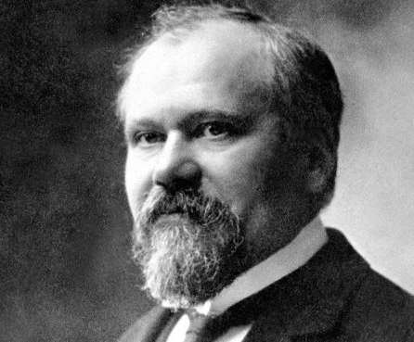
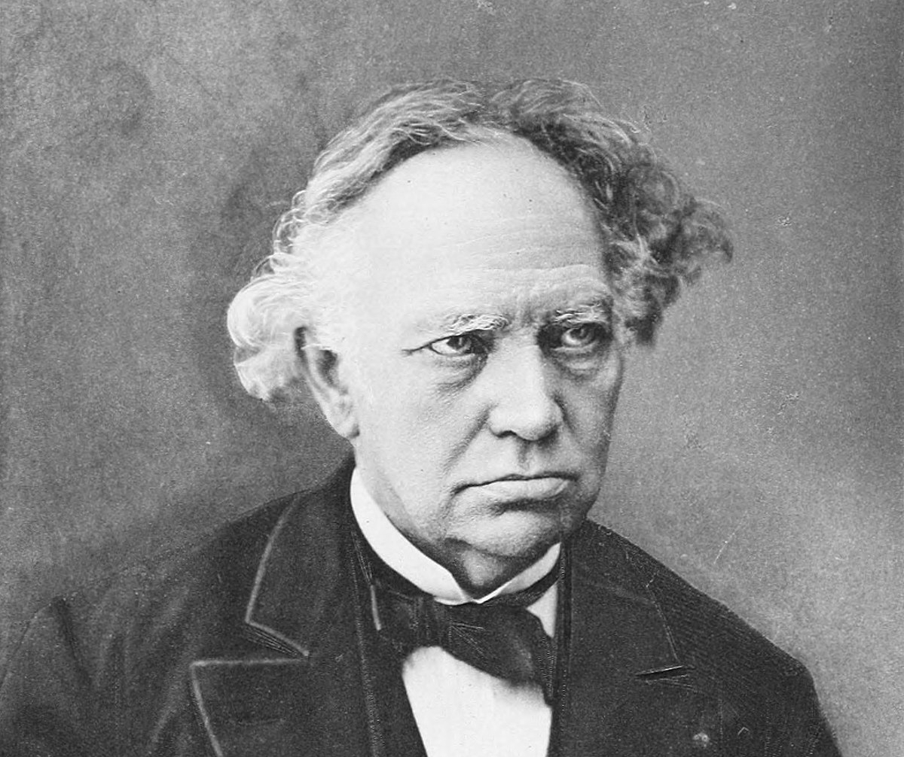
What is AI?
Charles Hermite’s 1858 work on polynomial equations presaged the symbolic manipulation methods that would later prove vital for computational processes (Hermite, “Sur la résolution de l’équation du cinquième degré,” 1858).
Louis Bachelier’s Théorie de la spéculation (1900) offered probabilistic concepts that eventually shaped the foundations of machine learning.
Henri Poincaré’s Science and Hypothesis (1902) provided an epistemological framework for grappling with uncertainty, an idea that continues to resonate in modern AI discussions.
Alan Turing advanced the field significantly by theorizing the “universal machine” and initiating the question of whether machines can “think” (Turing, “Computing Machinery and Intelligence,” Mind, 1950).

Slide 8
What is AI and Why it Matters?
Generative AI (Goodfellow et al., “Generative Adversarial Nets,” Advances in Neural Information Processing Systems, 2014).
Explicative AI (Miller, “Explanation in Artificial Intelligence: Insights from the Social Sciences,” Artificial Intelligence, 2019).
Predictive AI (Russell & Norvig, Artificial Intelligence: A Modern Approach, 2020).
Distinguishing among generative, explicative, and predictive AI is crucial for clarifying their respective aims, methods, and potential risks.

Slide 9
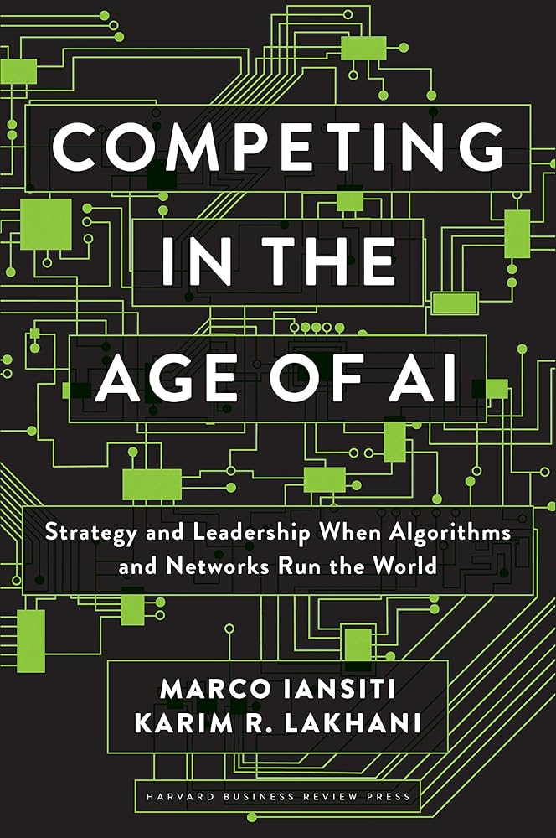
AI and Society: An Economic Perspective
Since the late twentieth century, AI’s value creation has shifted from focusing on algorithmic sophistication to leveraging large-scale data.
Multi-sided platforms exploit user-generated data to generate advertising-driven revenue, while offering services nominally for “free” (Parker, Van Alstyne, & Choudary, Platform Revolution, 2016).

Slide 10
AI and Society: A Multidisciplinary Perspective
« If you don’t buy the product, you are the product »
This data-centric model raises regulatory, consumer protection, and environmental concerns, given the intensified computational demands and related ecological footprints.

Slide 11
AI and Society: A Multidisciplinary Perspective
Beyond economic impacts, AI reshapes social norms by mediating information flows and influencing communication, echoing Jürgen Habermas’s theories of communicative action (Habermas, The Theory of Communicative Action, 1984).

Slide 12
AI and Society: A Multidisciplinary Perspective
Concentrated ownership of AI infrastructure in a limited number of global hubs raises questions about equity, dependence, and the challenges of forging international governance frameworks.
Geopolitically, AI (= DATA) expertise constitutes a strategic resource, sparking competition among dominant economies and igniting debates over digital sovereignty (Acharya, The End of American World Order, 2014).

Slide 13
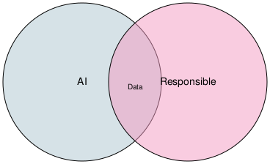

Slide 14
AI and Society: A Multidisciplinary Perspective
Framed this way, it becomes apparent how crucial it is to match each type of AI usage—generative, explicative, or predictive—to the specific context in which it operates.
For instance, a generative model deployed in creative industries poses different ethical and regulatory conundrums than a predictive system used for credit scoring.
A thorough assessment of these distinctions can guard against “wrong trajectories” of debate.

Slide 15
Conclusion
Global technological effects surpass the confines of individual nations, necessitating international cooperation rather than isolated or localized strategies.
Addressing AI’s varied manifestations—whether generative, explicative, or predictive—under a clear, structured framework allows stakeholders to establish consistent standards, exchange best practices, and devise fair governance structures.
Understood in these terms, Society 5.0 is not just a forward-looking concept; it becomes a practical call to action grounded in collective recognition of today’s complex challenges.
By foregrounding interdisciplinary inquiry, decision-makers can better formulate holistic, ethically conscious, and sustainable approaches to AI and its societal ramifications.

Slide 16
Conclusion
Multidisciplinarity is essential for identifying and addressing the full spectrum of potential issues, while interdisciplinarity is indispensable for formulating comprehensive and coherent solutions.

Slide 17
Conclusion
Thank you!

